Slide 1
Final Project Presentation
Group 7

Slide 2
Group Members
Carlos Miguel Pineda
Kyle Bryan Ong
Project Manager
Requirements Analyst
Karlo Tuazon
Marcelus Jarabe
Front End Developer
Back End Developer
Sean Harris Bautista
Database Developer

Slide 3
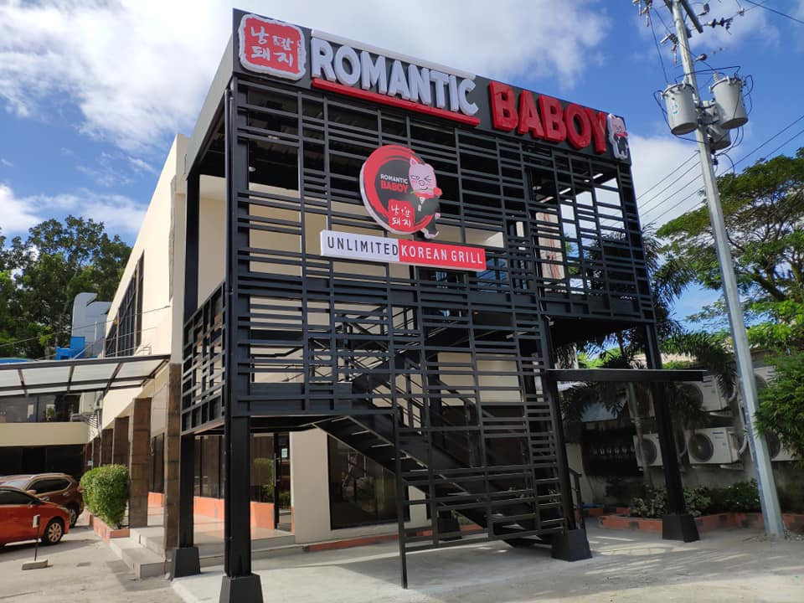
Client
Name:
Position:
Company:
John Leo H. Ang
Treasurer
Romantic Baboy Bacolod

Slide 4
Problem Statement
Physical documents are difficult to access and disseminate to stakeholders especially in times of pandemic.

Slide 5
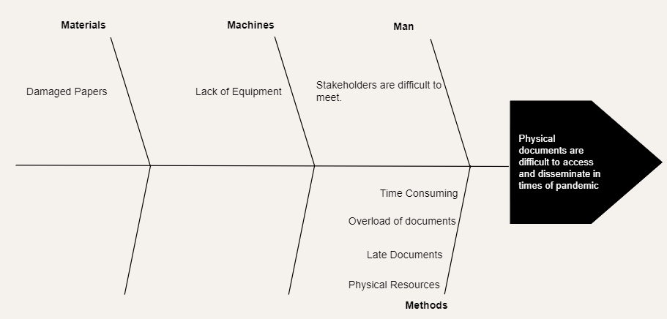
Problem Statement

Slide 6
The Project
Online Document Management System
Create an online document management system for the digitalization and management of documents to provide easier access for the client and stakeholders.

Slide 7
Requirements
Document Groups listed in the main page must be sortable.
Document Groups must be able to store more than one file.
Details should have a text box for noting down prerequisite files needed to obtain a certain document.
Details such as name, type, expiration, and prerequisite files must be editable.

Slide 8
Requirements
The attached files within a document group should be listed.
It should be possible to upload new files to an existing document group as well as delete existing ones.
There should be a registration page to be managed by the client or an assigned representative.

Slide 9
Mockup Prototype

Slide 10
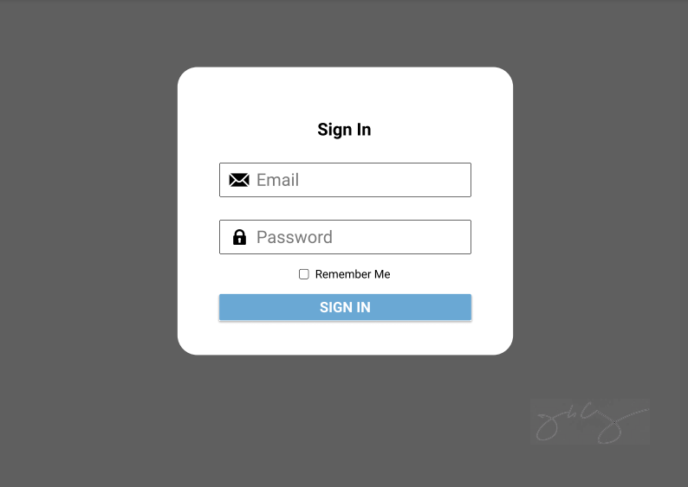
Login page

Slide 11
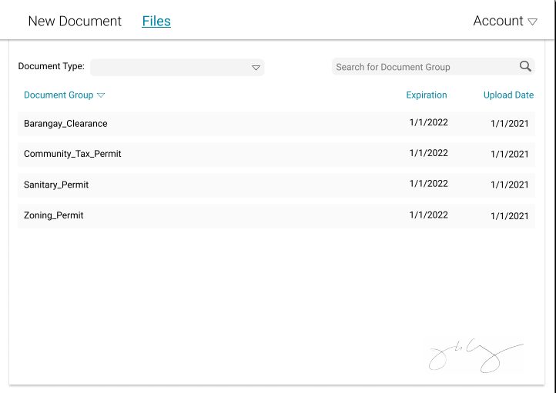
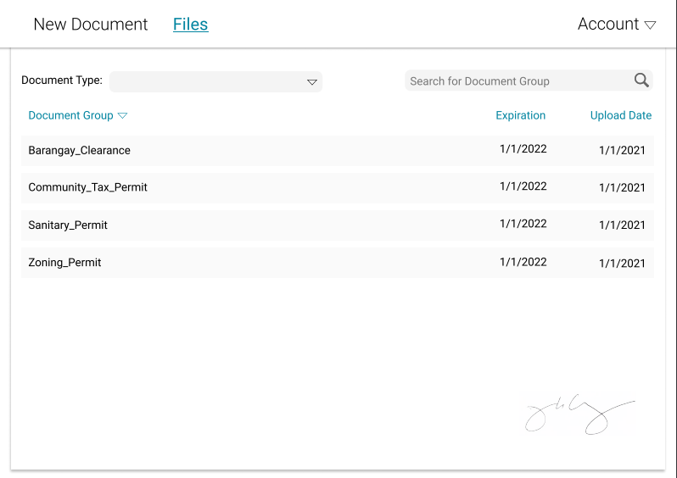
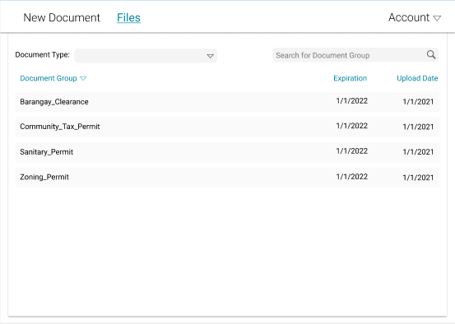
Files Page

Slide 12
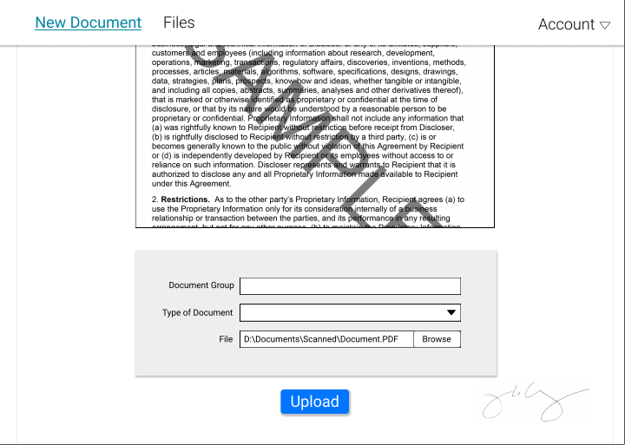
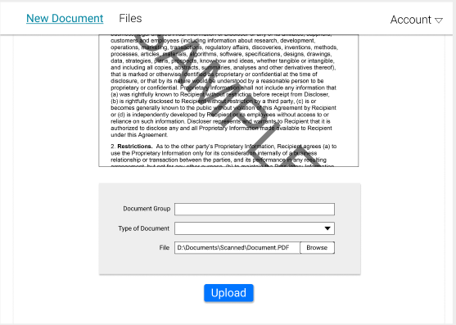
New Document Page

Slide 13
Files Page

Slide 14
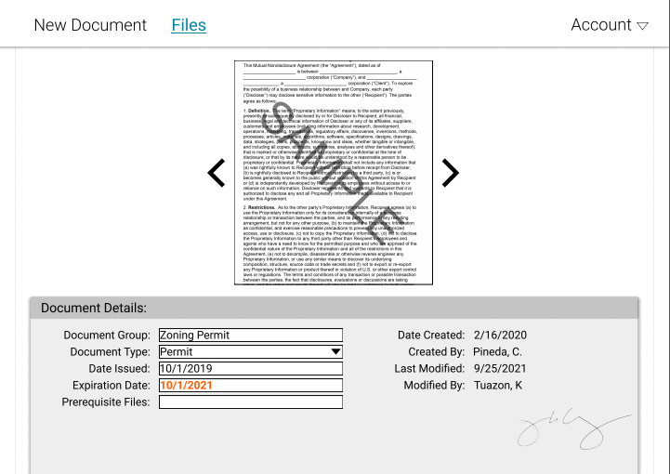
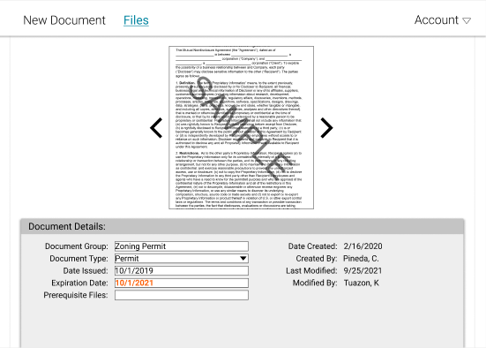
Document Details

Slide 15
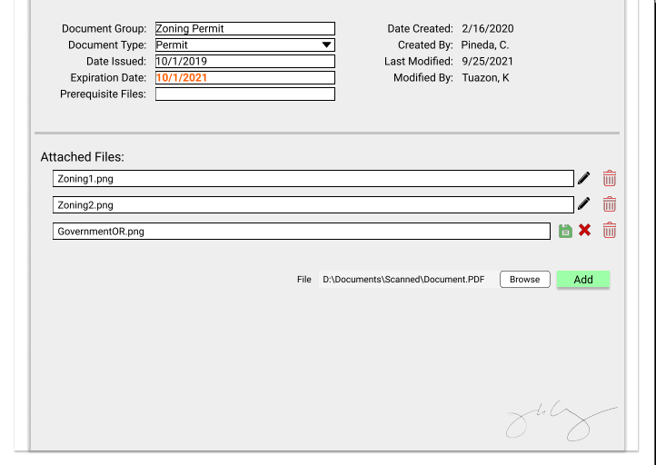
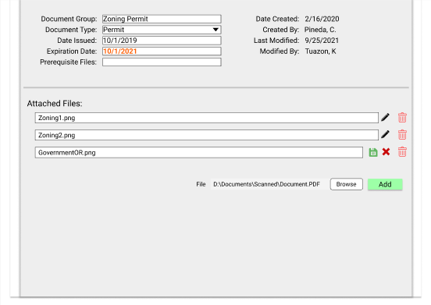
Document Details

Slide 16
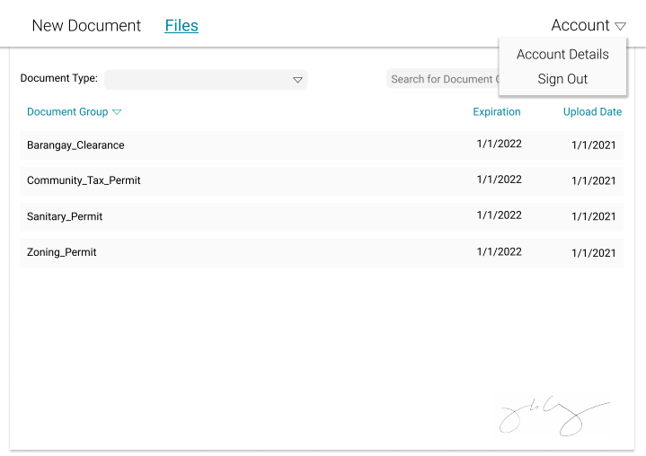
Account Tab

Slide 17
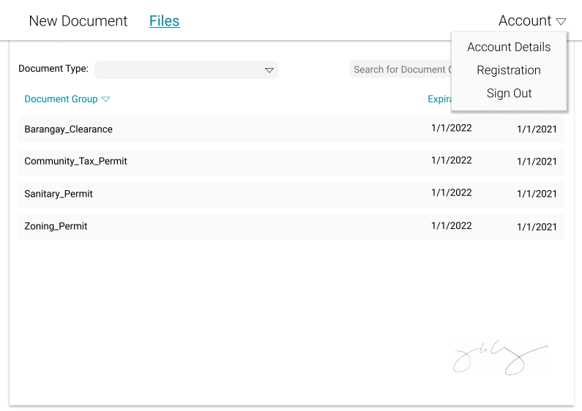
Account Tab (Admin)

Slide 18
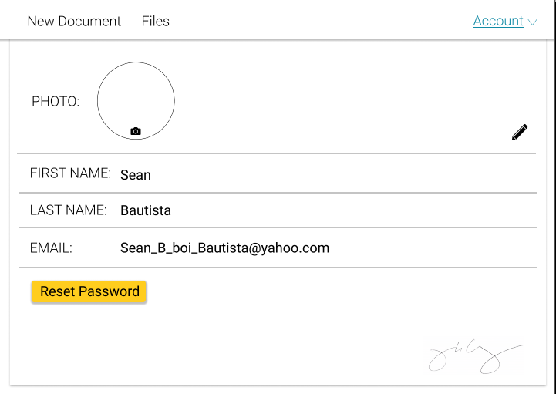
Account Details Page

Slide 19
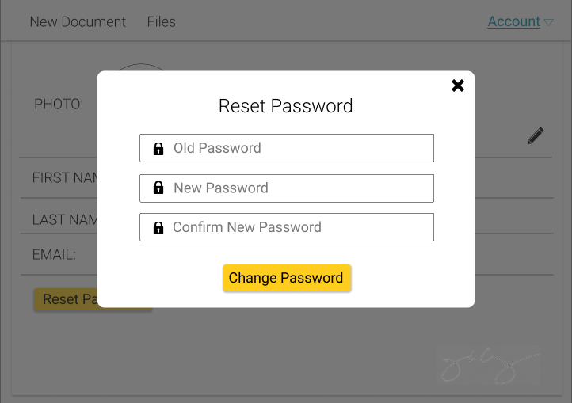
Reset Password

Slide 20
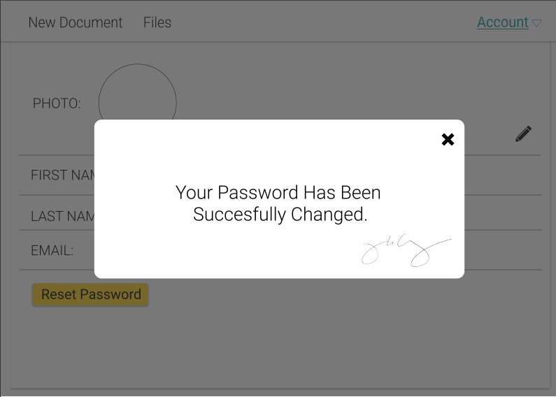
Reset Password

Slide 21
Account Tab (Admin)

Slide 22
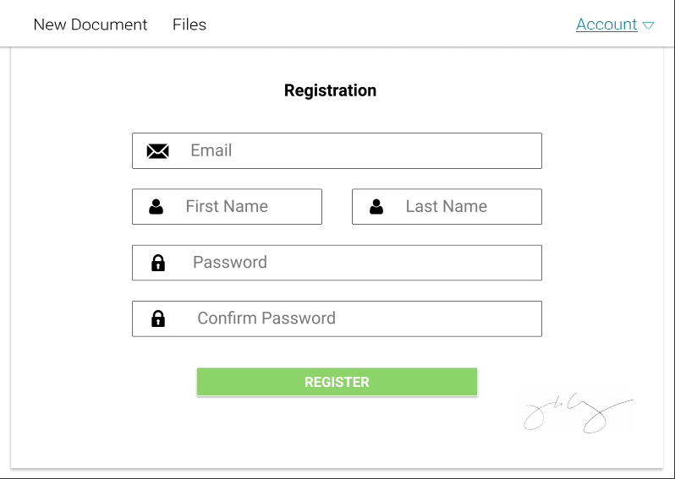
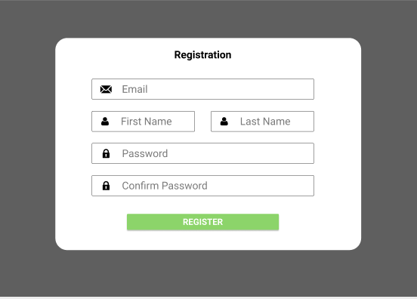
Registration Page

Slide 23
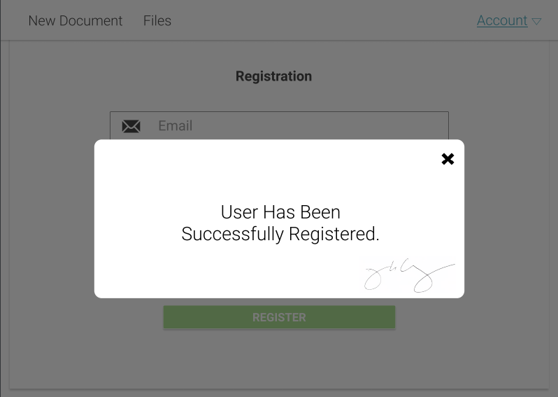
Registration Page

Slide 24
Database Design and Implementation

Slide 25
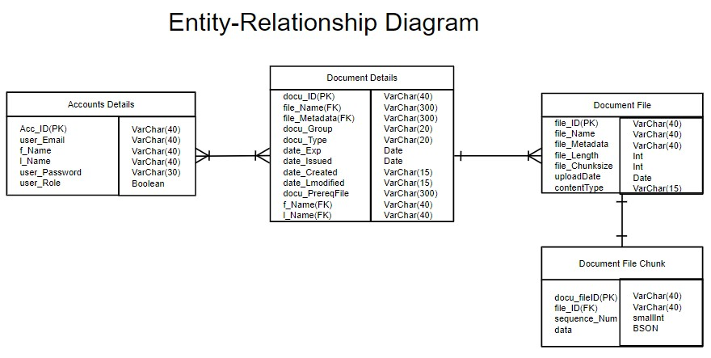
Entity Relationship Diagram

Slide 26
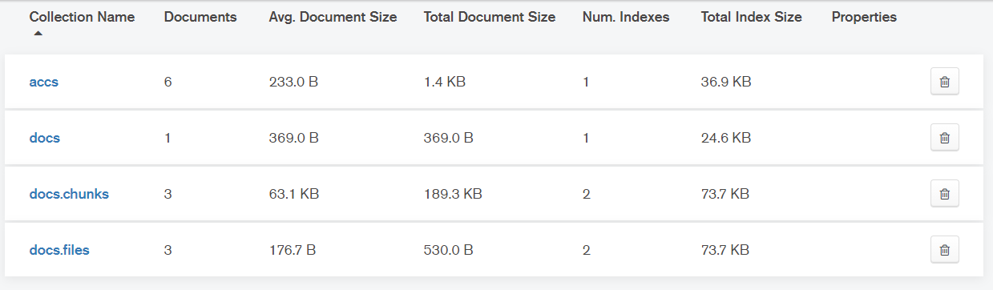
Mongodb-Atlas

Slide 27
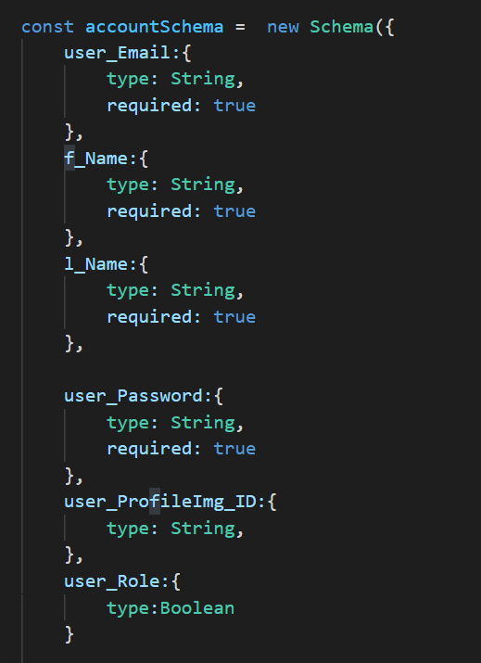
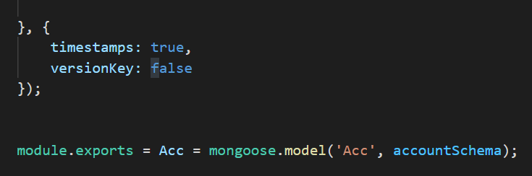
Account Schema

Slide 28
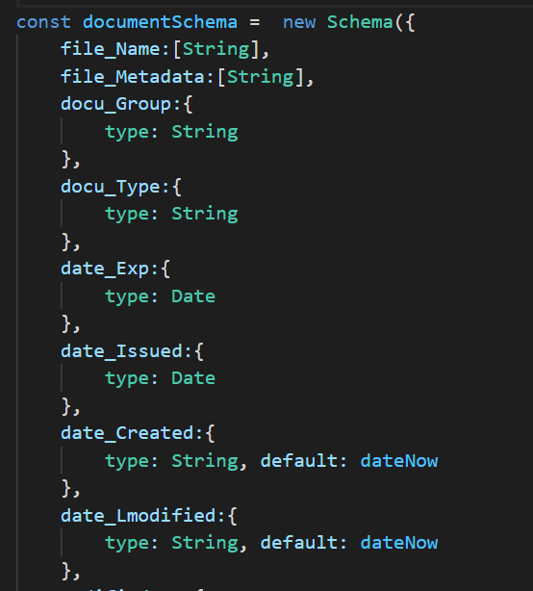
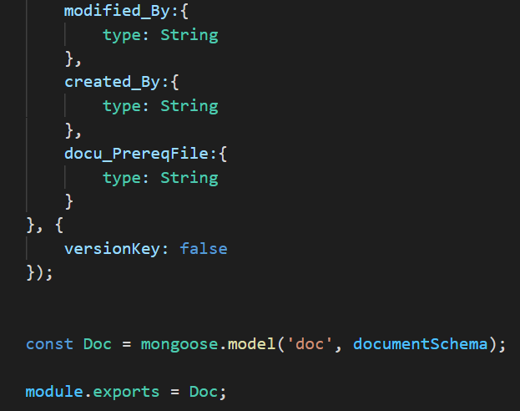
Document Schema

Slide 29
Git Repository

Slide 30
Deployed
Web Project Walkthrough

Slide 31
Summarized Contribution of Each Members

Slide 32
Thanks for Listening

